Slide 1

Security Advanced
SecAdv Group II
Toegepaste Informatica | SNB
[THM] Red & Blue
< Deep Dive >
Console.WriteLine(Maxim Meus, Khalid Ait Bouzid, Demian Hamers, Rasmus Leseberg);
}

Slide 2
Contents
<Contents>
SecAdv Groep II
}
SSRF & Burp Suite
Brim
Volatility & Memory Forensics
OSINT & Sakura Room
Reverse Shell
LLMNR poisoning
Privilege Escalation
}

Slide 3
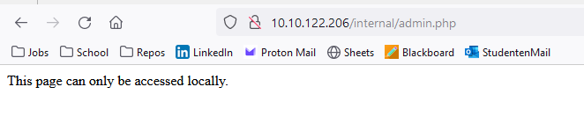
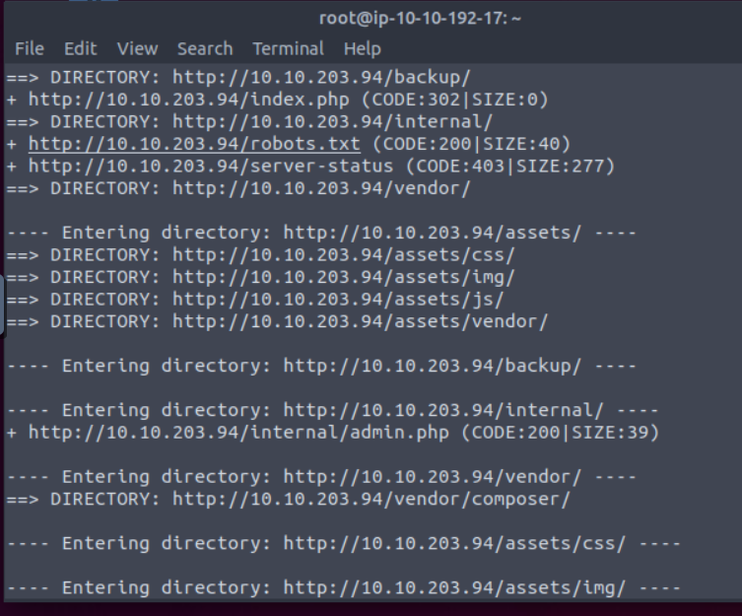
SSRF {Server Side Request Forgery}
<SSRF>
Sec Adv II
SSRF?
Enumeration
Dirbuster
Internal Footprinting
Input Sanitization
URL filtering

Slide 4
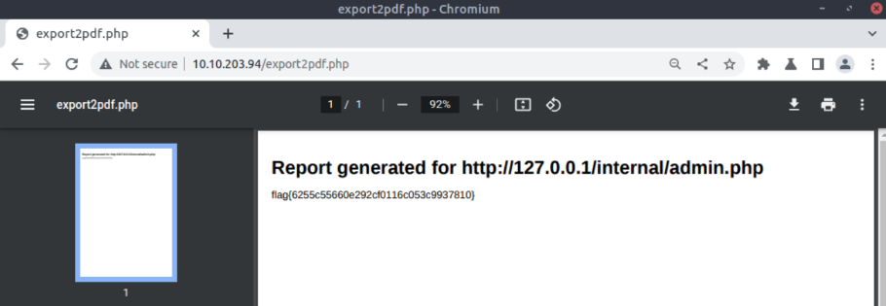
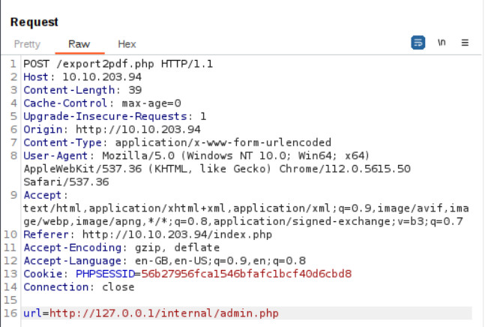
Burp Suite {HTTP Proxy}
<Burp Suite & MITM>
Sec Adv II
HTTP Intercept
Proxy
MITM
Repeater
SSL/TLS
HSTS

Slide 5

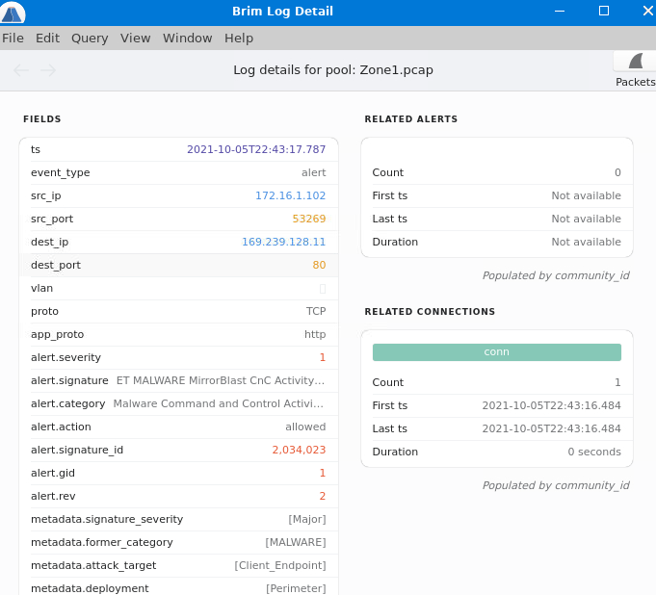
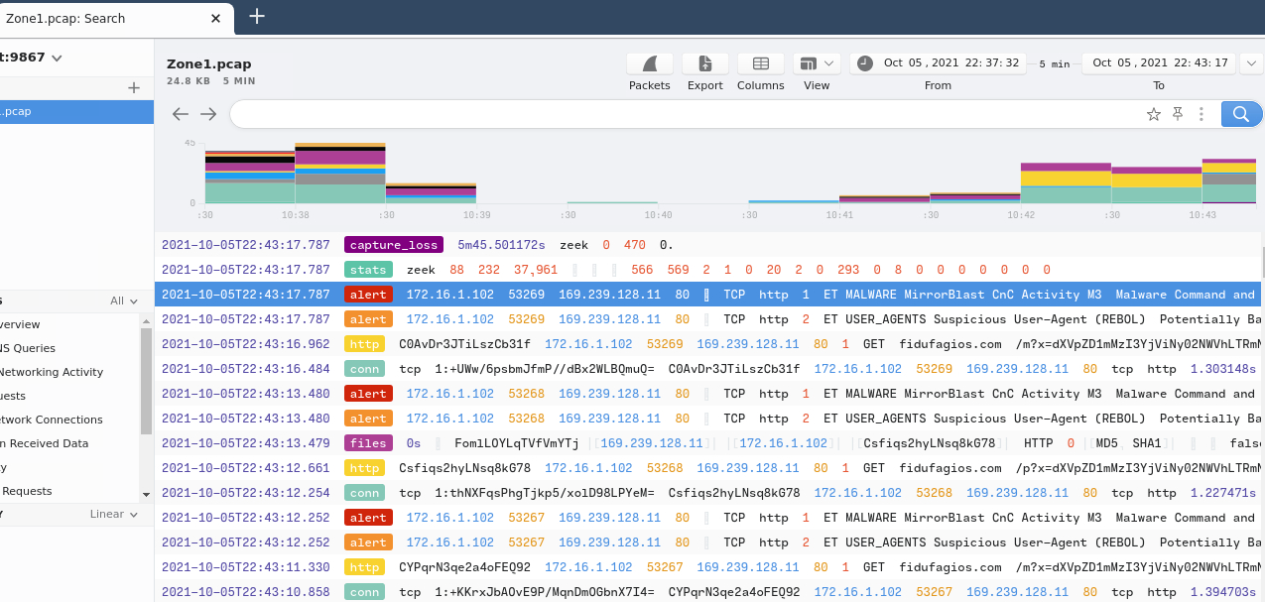
BRIM {network forensics}
<BRIM>
Sec Adv II
Open Source
PCAP
// Warzone 1 & PrintNightmare, thrice room
Notes:
PCAP: zijn data files die gemaakt zijn met een programma, in deze files hebje data packets van een netwerk en die worden gebruiken om de netwerkkaraktereigenschappen te analyseern

Slide 6

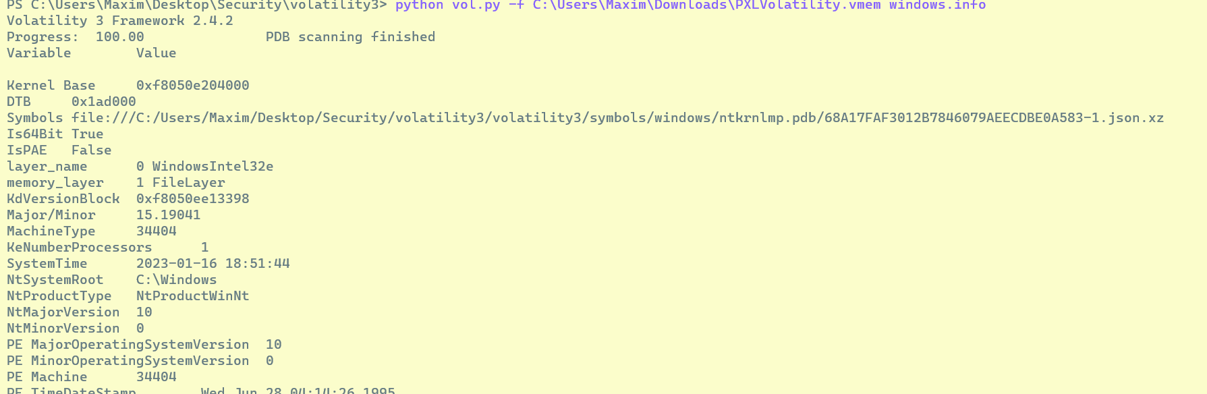
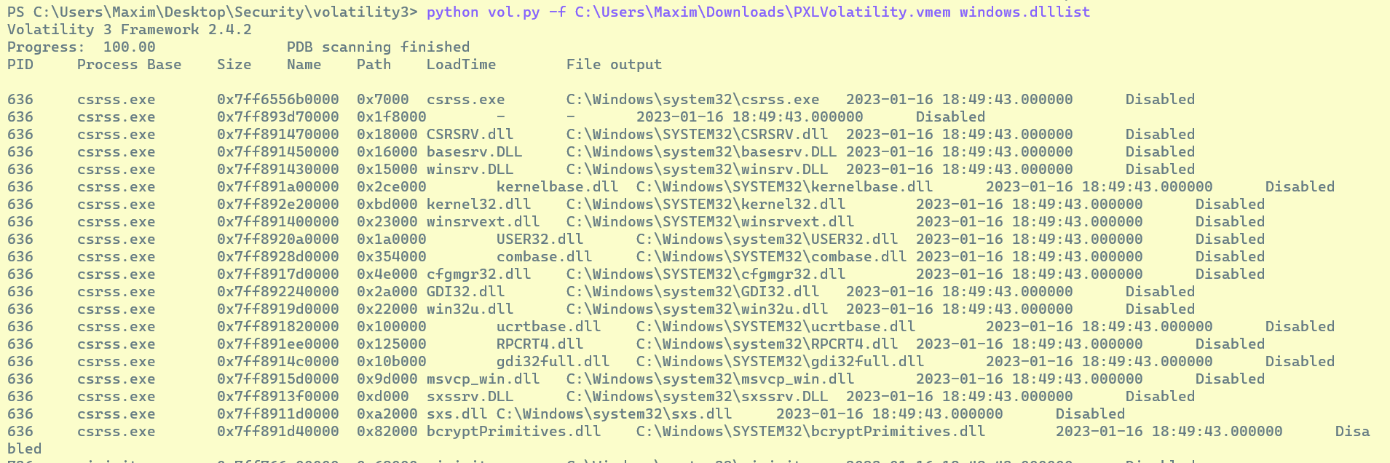
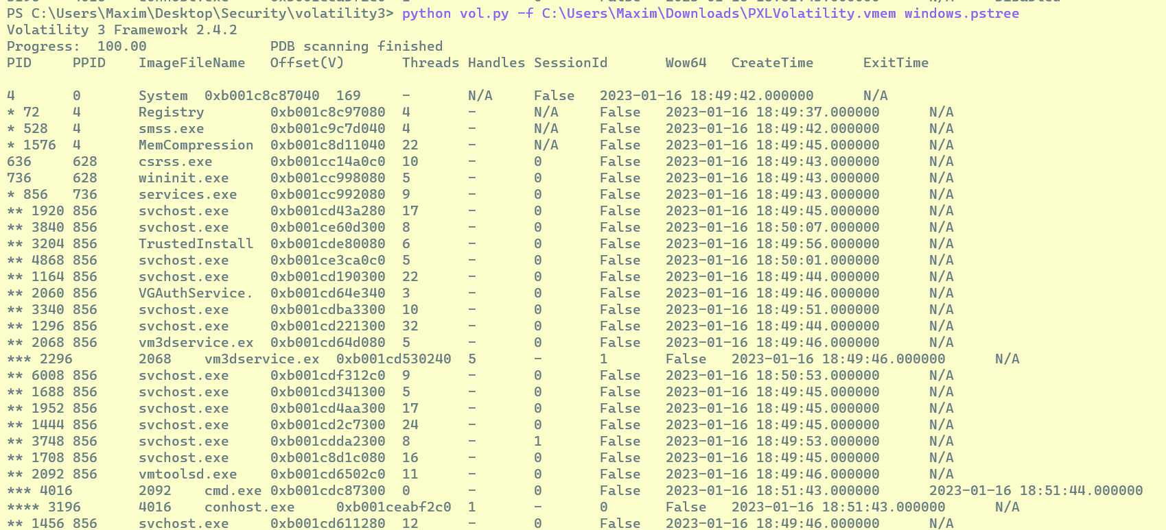
Volatility {memory forensics}
<Volatility>
Sec Adv II
Open Source
VMEM
Memory Extraction

Slide 7
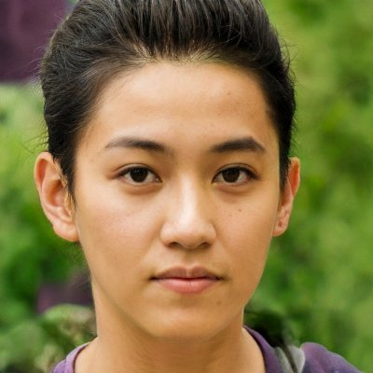
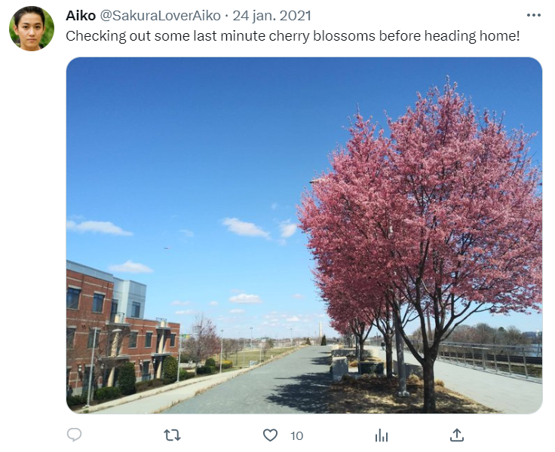

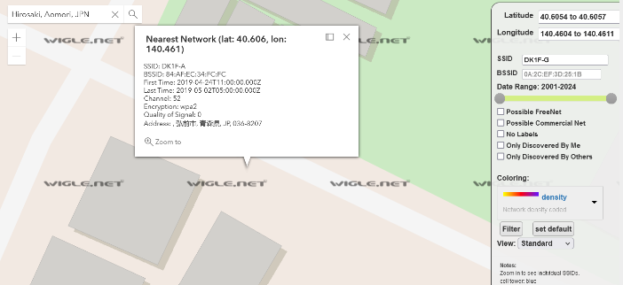
Sakura {Not so secure}
<OSINT>
Sec Adv II
Not so smart
Creeping on the attacker
More creeping

Slide 8
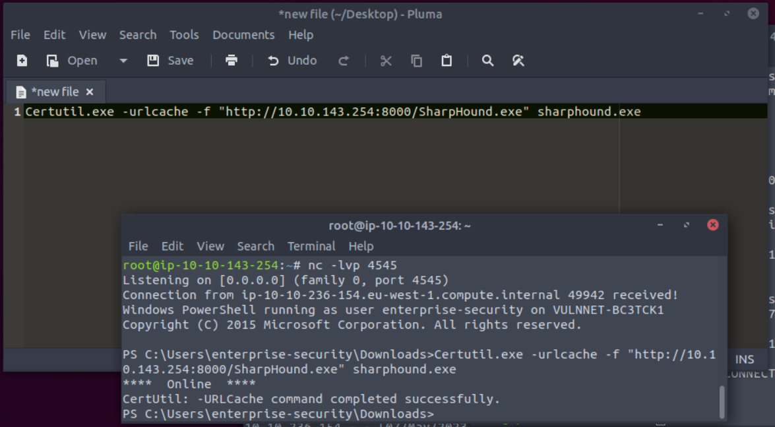
Reverse Shells {HTTP Proxy}
<Remote Code Execution>
Sec Adv II
What is a Reverse Shell?
Remote Code Execution
SMB & Port 4444
HTTP mirror setup
Script
Enumeration

Slide 9
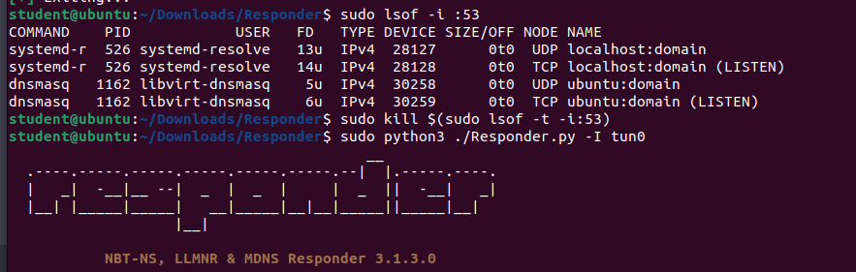
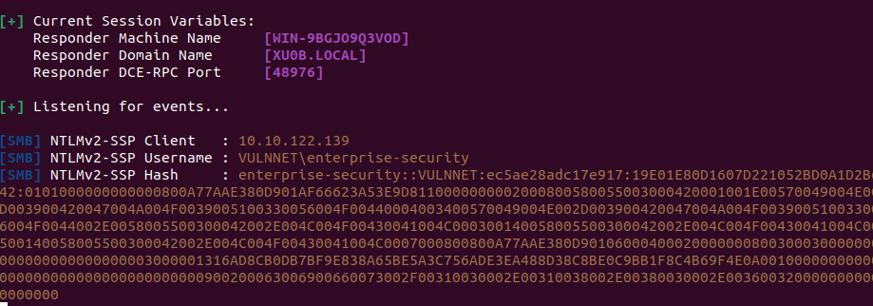
LLMNR poisoning {Windows protocol}
<LLMNR & Responder>
Sec Adv II
What is LLMNR?
DNS failure
MITM
NTLMv2
Responder
Prevention

Slide 10
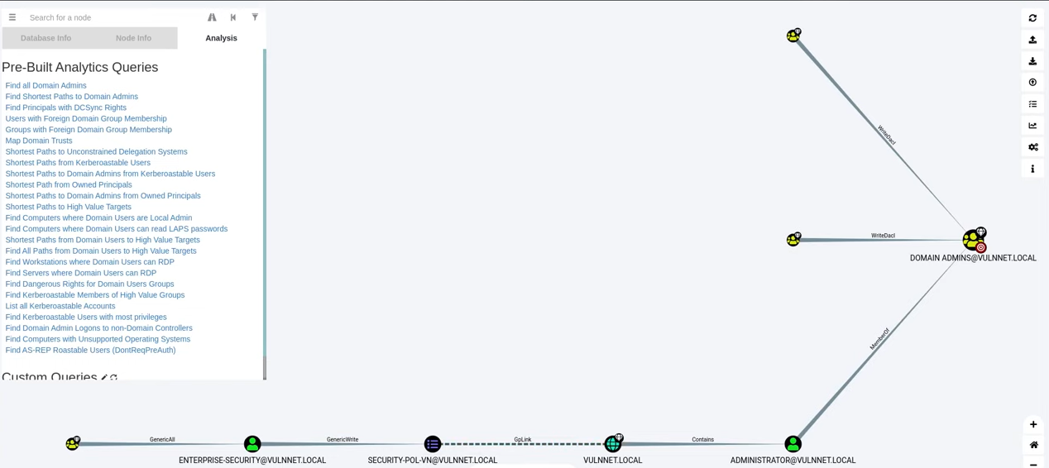

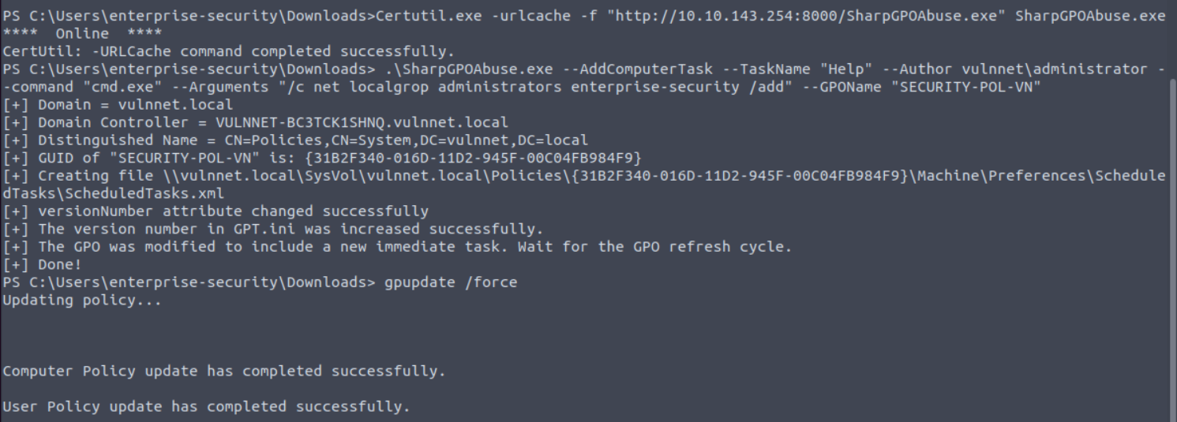
Privilege Escalation {Bloodhound}
<Privilege Escalation>
Sec Adv II
Active Directory Mapping
SharpGPOAbuse
Group Policies
Data collection van BH
Privilege Escalation Techniques in AD

Slide 11
Questions {?}
?
Sec Adv II
TeamGrading: true

